Slide 1
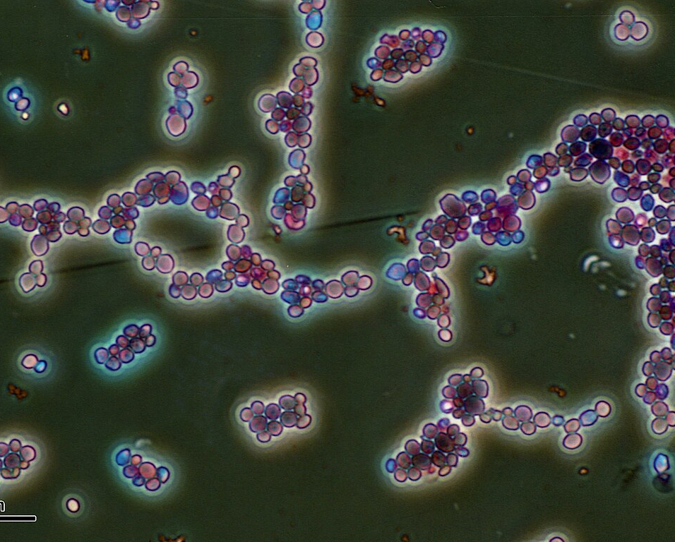
Species-Level Clustering of Candida Using ITS and ERG11 Gene Sequences
Sabrina Saiphoo
https://github.com/snsaiphoo/binf6210_assignment4.git
Notes:
https://commons.wikimedia.org/wiki/File:Candida_albicans_%28251_12%29.jpg

Slide 2
Species Clustering & Antifungal Resistance in Candida
Candida species cause a wide range of human fungal infections and can vary greatly in antifungal resistance (Whaley et al., 2017).
This project explores how high- and low-resistance Candida species cluster using two fungal marker genes.
High resistance concern → Candida auris, Candida glabrata, Candida krusei (Chowdhary et al., 2017; Arendrup et. Al., 2017),
Low resistance concern → Candida albicans, Candida parapsilosis, Candida tropicalis (Nascimento et al., 2024)
The fungal markers are:
ITS – internal transcribed spacer, fungal barcode (Schoch et al., 2012)
ERG11 – involved in ergosterol synthesis, drug-target gene linked to azole resistance (Whaley et al., 2017)
Understanding these clustering patterns may provide insight into whether gene choice (ITS vs ERG11) reflects clinically meaningful resistance categories.

Slide 3
Resistance patterns are known, but clustering patterns are not
High and low-resistance Candida species are well documented in clinical antifungal susceptibility studies (Whaley et al., 2017).
However, it is unclear whether these resistance categories also emerge from genomic sequence variation when analyzed with unsupervised clustering.
Although the ITS and ERG11 genes are widely used in fungal genomics, their ability to reflect resistance groups in clustering analyses is something to be explored (Schoch et al., 2012; Whaley et al., 2017).
Gap in knowledge:
Do high-resistance species cluster differently than low-resistance species when applying unsupervised sequence-based methods?
Understanding this relationship will help determine whether gene choice in clustering influences species separation patterns.

Slide 4
Unsupervised clustering to compare high- and low-resistance Candida species.
The project is an exploratory, unsupervised clustering analysis.
Objective:
Compare whether high and low-resistance Candida species show distinct clustering patterns when analyzing ITS and ERG11 gene sequences.
Research Question:
Are there differences between high resistance concern species vs lower resistance concern species?
Does ITS vs ERG11 give different clustering patterns?
Approach: Obtain ITS and ERG11 gene data from the 6 chosen Candida species and perform unsupervised clustering from pairwise distance matrices and display results from NMDS, PCA, and evaluate cluster quality.

Slide 5
Candida Data NCBI
Data Source:
ITS and ERG11 gene sequences were obtained from NCBI Nucleotide Database (GenBank) through R’s rentrez package.
The analysis presented is based on the dataset retrieved on December 5th, 2025, as the data get continuously updated on each run of the script.
Dataset Properties:
500 Raw ITS and ERG11 sequences per query with length filters:
  ITS: 400-800 bp – (values were chosen from Schoch et al., 2012)
  ERG11: 1000-2500 bp – (values were chosen from de Oliveira Ceita et al., 2014)
After filtering for a balanced dataset per gene:
  84 ITS sequences (14 samples per species)
  30 ERG11 sequences (5 samples per species)

Slide 6
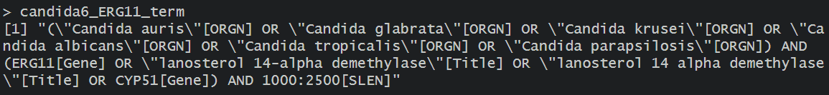
Key Variables & NCBI Search Terms
Key variables:
Gene of Interest: ITS or ERG11)
Species of Interest:
  High resistance concern: Candida auris, Candida glabrata, Candida krusei
  Low resistance concern: Candida albicans, Candida parapsilosis, Candida tropicalis
Search Terms:
Reference: https://www.ncbi.nlm.nih.gov/nucleotide/

Slide 7

Methods
Retrieved ITS (400-800 bp) and ERG11 (1000-2500 bp) sequences for 6 Candida species using rentrez.
Standardized species names. Balanced the dataset by selecting an equal number of sequences per species.
Measured sequence similarity using both alignment-based distances and simple sequence features.
Performed hierarchical clustering, PCA, and NMDS to visualize how sequences cluster by species and resistance group.
Used silhouette and Dunn indices to quantitatively compare clustering performance between ITS and ERG11.

Slide 8
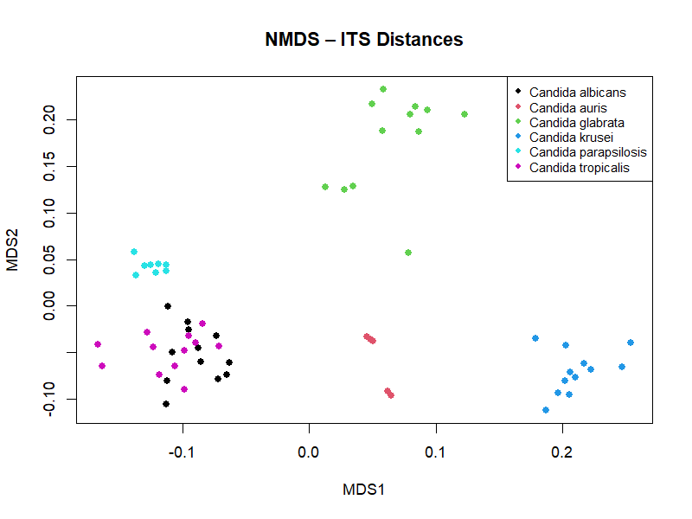
Figure 1 – ITS NMDS

Slide 9
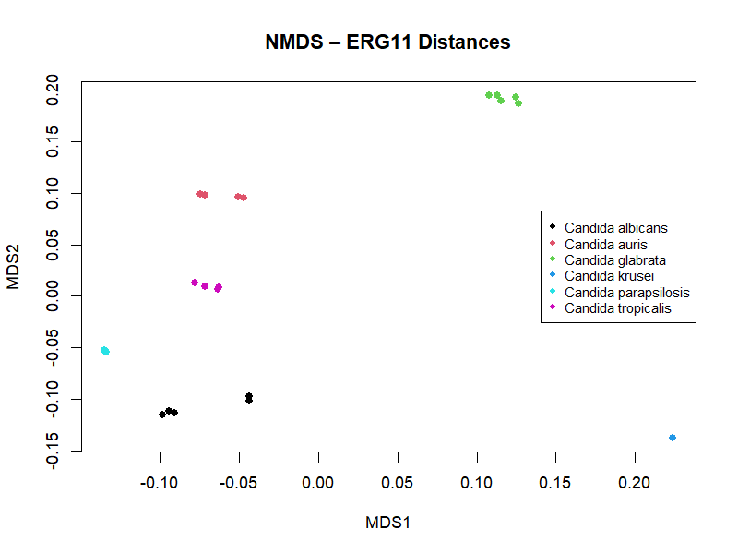
Figure 2 – ERG11 NMDS

Slide 10
ERG11 separates species more clearly than ITS, which shows overlap between resistance groups.
Non-metric Multidimensional Scaling (NMDS):
ITS → Most species from their own regions except Candida tropicalis and Candida albicans, these ones overlap. (Figure 1)
  The high resistance strains were isolated, low resistance had overlap.
ERG11 → Species clusters are more compact and more clearly separated. (Figure 2)
  All were quite separated, no overlap, but also smaller sample size.
Were the results expected?
ERG11 overall performed better than ITS for species separation, which was unexpected.
Answer to the question:
High- and low-resistance Candida species do show distinct clustering patterns individually, but the strength of separation differs by gene, with ERG11 providing clearer separation than ITS.

Slide 11
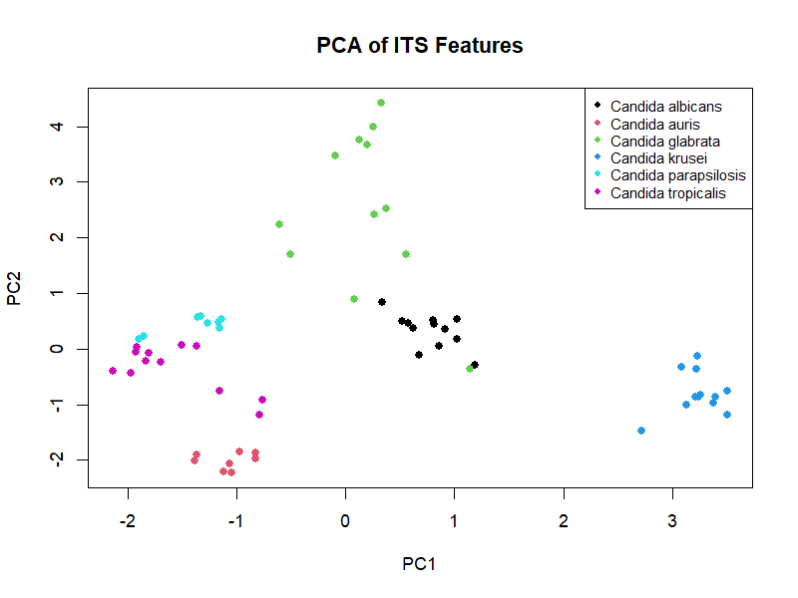
Figure 3 – ITS Feature-Based Clustering with PCA

Slide 12
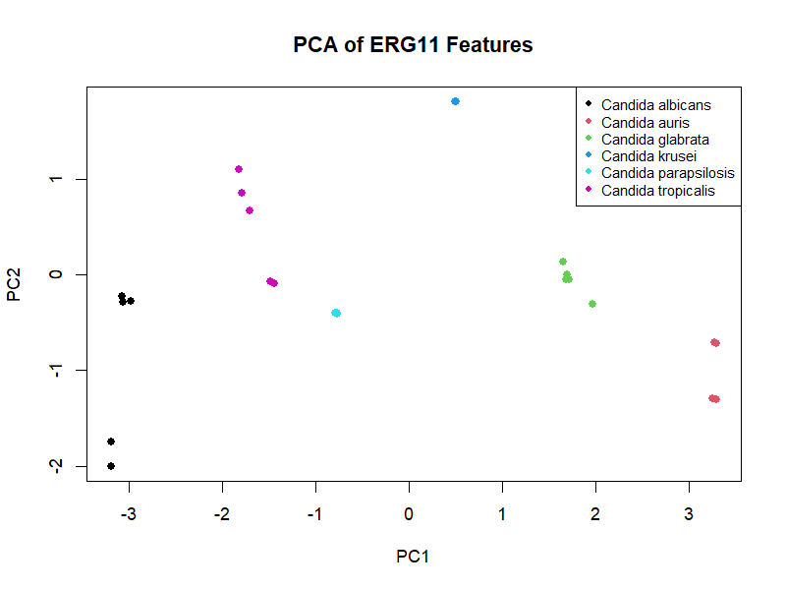
Figure 4 – ERG11Feature-Based Clustering with PCA

Slide 13
ERG11 PCA separates species more clearly than ITS, which shows overlap among several groups.
Feature-Based Clustering with PCA:
ITS → Candida glabrata and Candida albicans overlap substantially. Candida tropicalis and Candida parapsilosis show partial overlap. Candida krusei has an isolated cluster. (Figure 3)
ERG11 → Has a small sample size, and species clusters do not overlap. Displays compact clusters. (Figure 4)
Were the results expected?
It was unexpected that ERG11, a conserved functional gene, would separate species more clearly than the highly variable ITS region.
Answer to the original question:
Candida species show clearer separation in ERG11 PCA than ITS PCA, indicating that feature-based clustering strongly depends on gene choice. The high or low resistance concern species are isolated not clustering with each other.

Slide 14
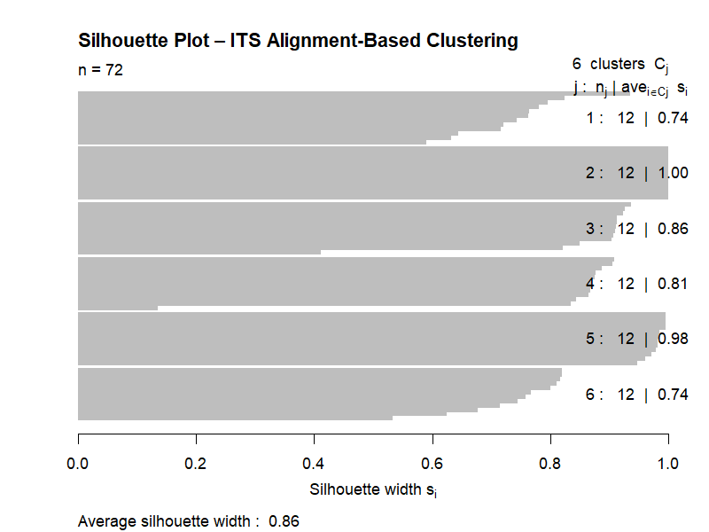
Figure 5 – ITS Silhouette plot

Slide 15
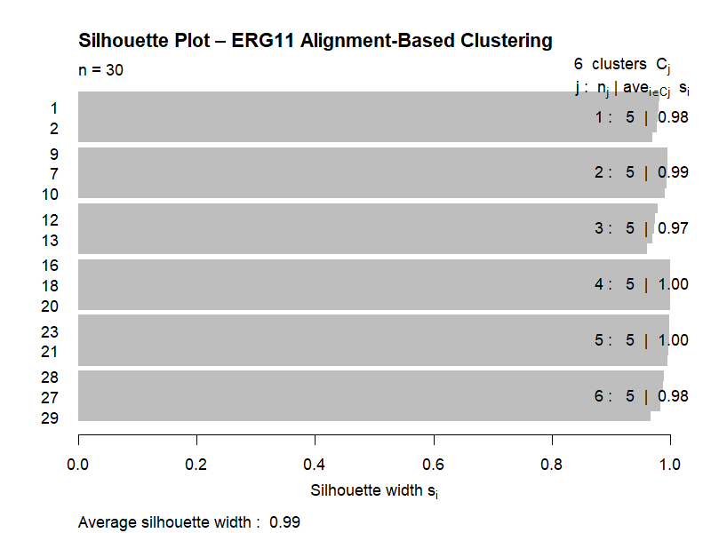
Figure 6 – ERG11 Silhouette plot

Slide 16
Silhouette Analysis Shows Stronger Clustering for ERG11 Than ITS.
Silhouette Analysis:
ITS → Showed a good but variable performance 0.74 – 1.00, reflecting partial overlap among several species. (Figure 5)
ERG11 → Achieved a 0.99 silhouette width, which each species cluster scoring between 0.97-100. (Figure 6)
These scores indicate that ERG11 provides the strongest and most confident species separation, consistent with the NMDS and feature-based clustering.
Were the results expected?
it was unexpected that ERG11, a more conserved functional gene, would outperform ITS, the highly variable fungal barcode, by producing nearly perfect silhouette scores.
Answer to the original question:
Both genes show distinct clustering patterns between Candida species, but ERG11 separates species far more clearly and consistently than ITS.

Slide 17
Interpretation is limited by uneven sample sizes and database bias
One limitation in this project was the big difference in sequence availability between the two genes. ITS is a standard fungal barcode, so there were plenty of sequences to work with (Schoch et al., 2012).
ERG11, on the other hand, is mainly studied in the context of azole resistance (Whaley et al., 2017), so it appears less often in public databases. This created a noticeable imbalance in sample size.
Because of that, even though ERG11 looked like it produced cleaner clusters, it’s hard to say whether this reflects true biological separation. This could just be an outcome of having fewer sequences. Smaller sample sizes are known to inflate silhouette widths and make clusters appear more distinct than they actually are (Wani et al., 2024).
So overall, while the ERG11 results were interesting, they can’t really be confirmed without analyzing a much larger ERG11 dataset or using curated fungal genome resources to validate the patterns.

Slide 18
Future work requires larger ERG11 datasets and testing more antifungal genes
Next Steps
Both NMDS and PCA showed that the high-resistance species clustered well individually, but they did not form a single “high-resistance group”.
The low-resistance species showed more overlap, so the original resistance-concern question wasn’t fully answered.
Because the ERG11 sample size was small, the next step would be to collect more ERG11 sequences to test whether these patterns hold.
I would also analyze additional antifungal genes to see whether functional genes consistently separate species better than ITS.
Preliminary Finding Worth Following Up
The fact that each high-resistance species clustered cleanly on its own is still a valuable signal and worth exploring further.
As antifungal resistance continues to rise, understanding how these genes vary across species is important, and this project provides an early look at those patterns.

Slide 19
Reflection
I chose to focus on clustering for this project because I already have more experience with supervised machine learning, and I wanted to push myself into something less familiar.
At the same time, I’ve recently started learning more about Candida and found the topic of antifungal resistance genuinely interesting, so this project felt like the perfect way to challenge myself while exploring a new research area. One of the biggest improvements for me was finally implementing a functions file having clean, reproducible code made everything so much more organized and easier to follow.
I definitely feel that my R skills have developed significantly through this course and these assignments. Overall, this project helped me grow both technically and personally, and I’m excited to bring these concepts and workflows into BINF*6999 and eventually into my future career.

Slide 20
Acknowledgements slide
I would like to acknowledge Sharon, for being readily available to answer questions and share ideas with. Sharon was also helpful in reminding me of specific rubric requirements.
I would also like to acknowledge Saira, for being responsive with emails and running my code prior to ensure my functions worked correctly!

Slide 21
References
Arendrup, M. C., & Patterson, T. F. (2017). Multidrug-resistant Candida: Epidemiology, molecular mechanisms, and treatment. The Journal of Infectious Diseases, 216(suppl_3), S445–S451. https://doi.org/10.1093/infdis/jix131
Chowdhary A, Sharma C, Meis JF (2017) Candida auris: A rapidly emerging cause of hospital-acquired multidrug-resistant fungal infections globally. PLoS Pathog 13(5): e1006290. https://doi.org/10.1371/journal.ppat.1006290
de Oliveira Ceita, G., Vilas-Boas, L. A., Castilho, M. S., Carazzolle, M. F., Pirovani, C. P., Selbach-Schnadelbach, A., Gramacho, K. P., Ramos, P. I., Barbosa, L. V., Pereira, G. A., & Góes-Neto, A. (2014). Analysis of the ergosterol biosynthesis pathway cloning, molecular characterization and phylogeny of lanosterol 14 α-demethylase (ERG11) gene of Moniliophthora perniciosa. Genetics and molecular biology, 37(4), 683–693. https://doi.org/10.1590/S1415-47572014005000017
Nascimento, T., Inácio, J., Guerreiro, D., Diaz, P., Patrício, P., Proença, L., Toscano, C., & Barroso, H. (2024). Susceptibility patterns of candida species collected from Intensive Care Units in Portugal: A prospective study in 2020–2022. Infection Prevention in Practice, 6(4), 100403. https://doi.org/10.1016/j.infpip.2024.100403
Schoch, C. L., Seifert, K. A., Huhndorf, S., Robert, V., Spouge, J. L., Levesque, C. A., Chen, W., Fungal Barcoding Consortium, & Fungal Barcoding Consortium Author List (2012). Nuclear ribosomal internal transcribed spacer (ITS) region as a universal DNA barcode marker for Fungi. Proceedings of the National Academy of Sciences of the United States of America, 109(16), 6241–6246. https://doi.org/10.1073/pnas.1117018109
Wani A. A. (2024). Comprehensive analysis of clustering algorithms: exploring limitations and innovative solutions. PeerJ. Computer science, 10, e2286. https://doi.org/10.7717/peerj-cs.2286
Whaley, S. G., Berkow, E. L., Rybak, J. M., Nishimoto, A. T., Barker, K. S., & Rogers, P. D. (2017). Azole Antifungal Resistance in Candida albicans and Emerging Non-albicans Candida Species. Frontiers in microbiology, 7, 2173. https://doi.org/10.3389/fmicb.2016.02173
Programming Resources:
prcomp function | R Documentation. (n.d.). Www.rdocumentation.org. https://www.rdocumentation.org/packages/stats/versions/3.6.2/topics/prcomp
cluster.stats function - RDocumentation. (2024). Rdocumentation.org. https://www.rdocumentation.org/packages/fpc/versions/2.2-13/topics/cluster.stats
metaMDS function - RDocumentation. (2025). Rdocumentation.org. https://www.rdocumentation.org/packages/vegan/versions/2.7-2/topics/metaMDS
hclust function - RDocumentation. (n.d.). Www.rdocumentation.org. https://www.rdocumentation.org/packages/stats/versions/3.6.2/topics/hclust
R Functions. (n.d.). Www.w3schools.com. https://www.w3schools.com/r/r_functions.asp

